Slide 1

ElectViz – Election Data Visualization for Media Project
By – Drishti Rathod

Slide 2
Project Introduction
ElectViz is an Election Data Visualization project developed for media and analytical purposes.
The objective is to transform raw election datasets into meaningful insights using interactive dashboards.
The project covers multi-year election data analysis with performance tracking.
Tool Used: Power BI for dashboard development.

Slide 3
Problem Statement
Election data is complex and large in volume.
Raw datasets do not directly provide insights.
Media and analysts require visual, quick, and comparative analysis.
Need for dynamic dashboards with filters and drill-down capabilities.

Slide 4
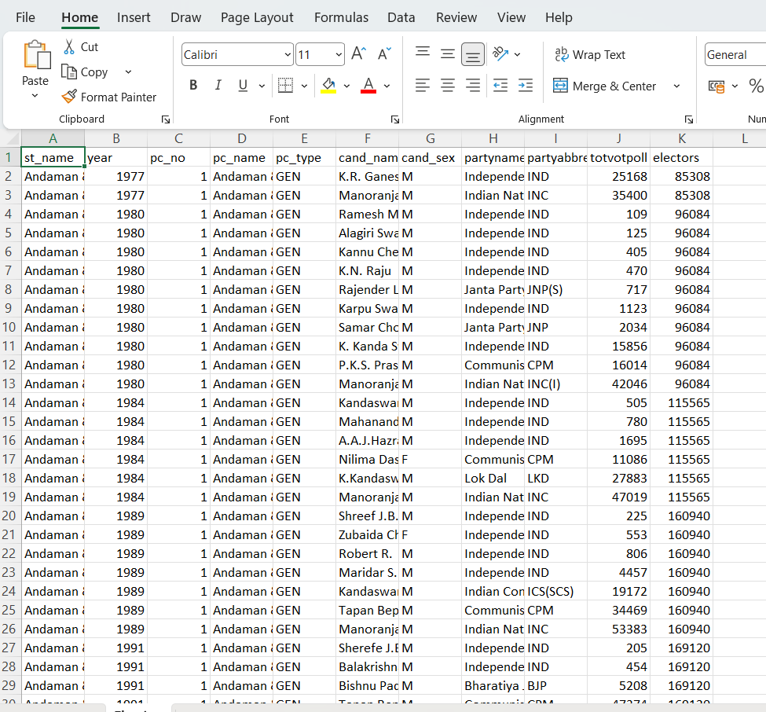

Slide 5
Data Cleaning – Steps Performed
Removed Duplicate Records
Checked duplicate rows based on:
year
state
pc_no
candidate
Ensured one candidate appears only once per constituency per year.
Removed accidental repeated entries. Handled Missing Values

Slide 6
Data Cleaning – Steps Performed
➤ In Vote Columns (totpoll)
Checked for blank or null vote values.
Replaced null values with 0 (if candidate existed but votes missing).
Removed rows where both candidate name and votes were blank.
➤ In Elector / Turnout Columns
Removed rows where electors was null.
Ensured no division errors while calculating Turnout %.
➤ In Gender Column
Replaced null values with other.

Slide 7
Data Preparation in Power BI
Imported cleaned dataset into Power BI.
Created calculated columns (e.g., is_winner).
Developed DAX measures for vote share, seat share, and totals.
Created Year slicer for dynamic filtering.

Slide 8
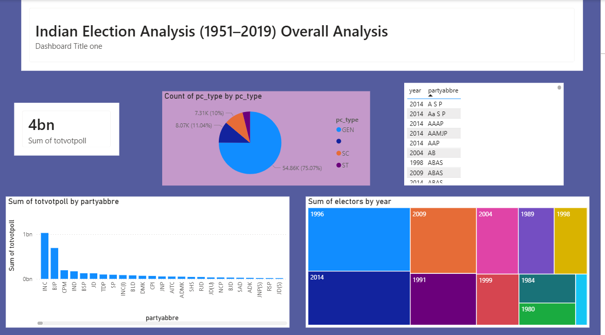
Overall Analysis Dashboard
Overview of Indian General Elections (1951–2019). • Total votes card highlights cumulative votes cast across years. • Constituency chart shows majority of seats are General category. • Party-wise chart indicates INC and BJP receive the highest votes. • Treemap shows steady growth in registered voters over time. • Year and party slicers enable interactive filtering. • Insight: Displays long-term election trends, voter growth, and major party dominance.

Slide 9
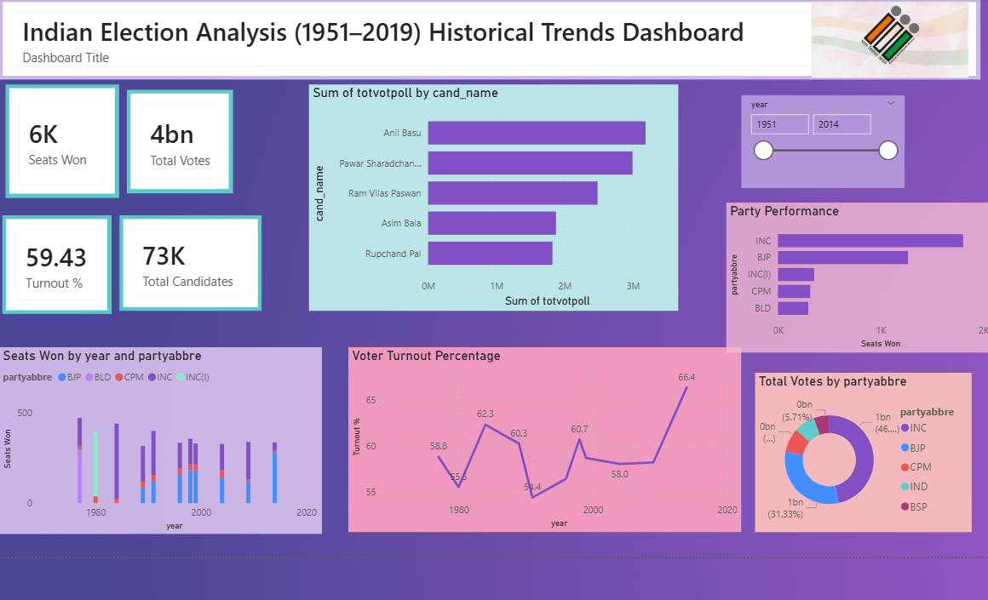
Historical Trends Dashboard
Shows historical trends of Indian General Elections (1951–2019). • KPI cards summarize seats won, total votes, turnout %, and candidates. • Candidate votes chart highlights top candidates by total votes. • Year slicer enables filtering and comparison across election years. • Party performance chart shows seats won by major parties (INC, BJP leading). • Stacked column chart shows party performance changes across years. • Insight: Reveals party dominance, candidate popularity, and shifts in political power over time.

Slide 10
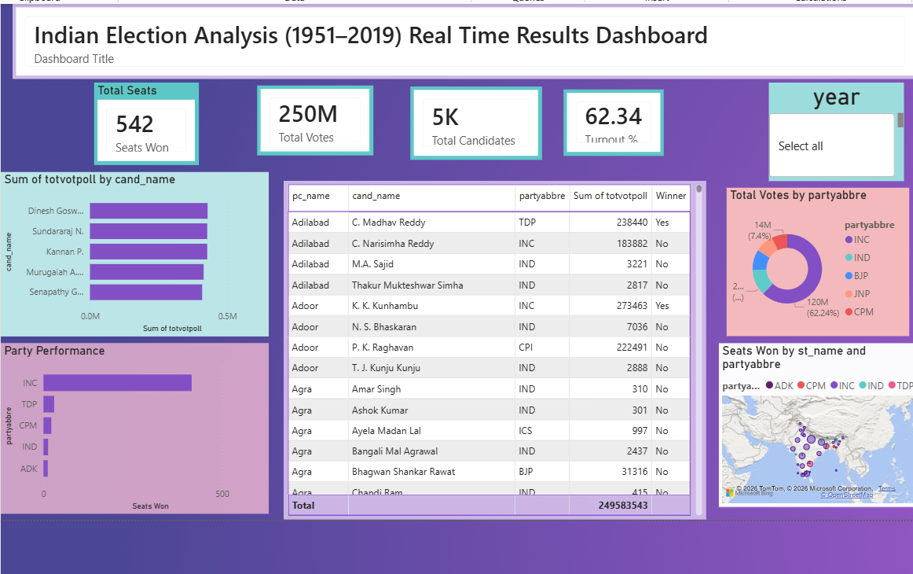
Real-Time Results Dashboard
Shows year-specific election results in a detailed interactive view. • KPI cards summarize seats won, total votes, candidates, and turnout %. • Year slicer filters the dashboard for a selected election year. • Candidate votes chart highlights top candidates in that year. • Table shows constituency-level details (constituency, candidate, party, votes, winner). • Insight: Enables detailed analysis of election results and candidate performance for a specific year.

Slide 11
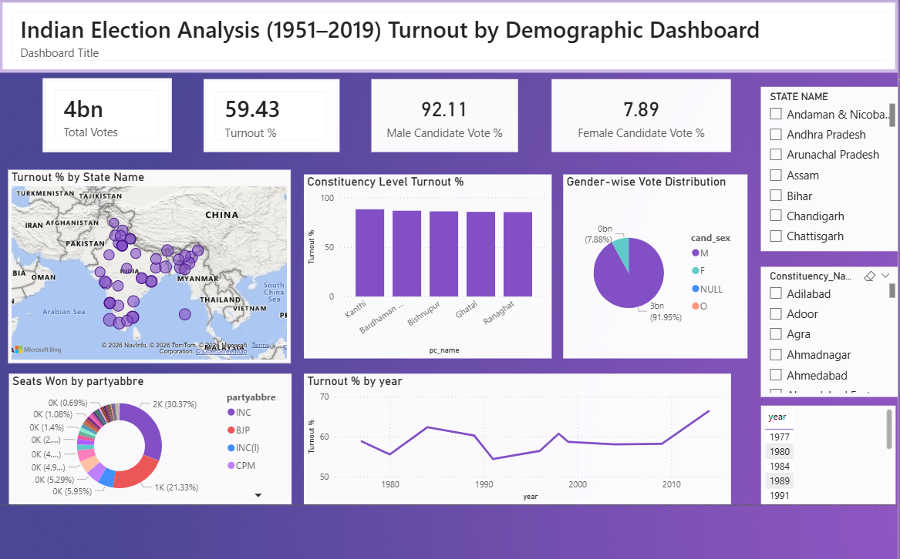
Turnout by Demographics
KPI cards summarize total votes, turnout %, and gender-wise vote share. • Map shows voter turnout percentage by state. • Bar chart compares turnout across constituencies. • Pie chart shows vote share between male and female candidates. • Donut chart shows seats won by different parties. • Line chart shows voter turnout trend across years. • Insight: Highlights voter participation patterns, regional turnout differences, and gender representation in elections.

Slide 12
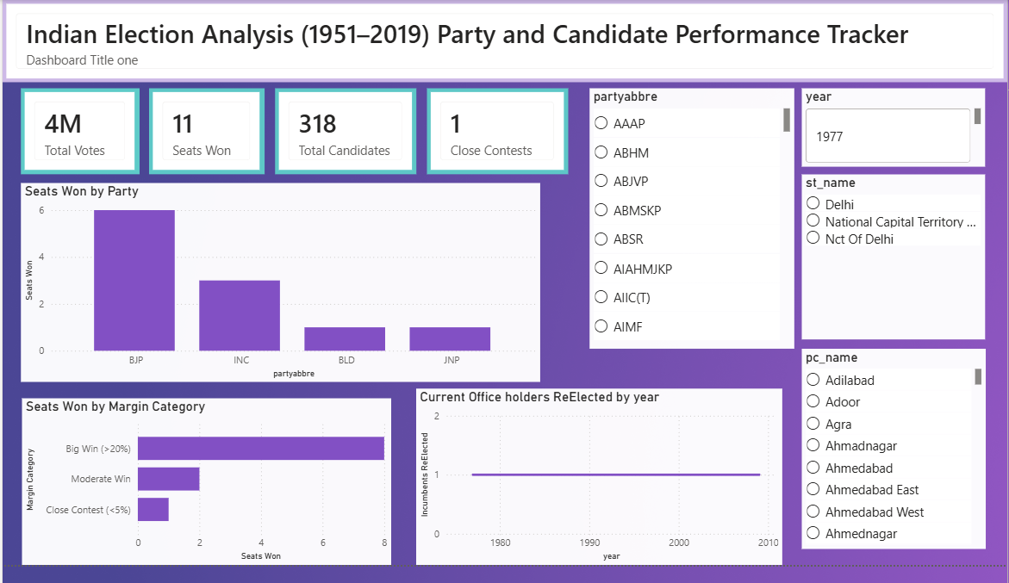
Party and Candidate Performance Tracker
KPI cards summarize total votes, seats won, candidates, and close contests. • Party chart shows seats won by each political party. • Margin chart categorizes wins into big, moderate, and close contests. • Line chart shows re-election trends of incumbents over time. • Filters allow analysis by party, year, state, and constituency. • Insight: Highlights election competitiveness, party dominance, and incumbency trends.

Slide 13
11 Key DAX Measures Used
Total Votes = SUM(election_data[total_votes]) – Calculates the total number of votes cast in the dataset.
Seats Won = COUNT(election_data[pc_name]) – Counts the total number of seats won in the selected context.
Total Candidates = DISTINCTCOUNT(election_data[candidate]) – Calculates the number of unique candidates who contested the election.
Turnout % = DIVIDE(SUM(election_data[total_votes]), SUM(election_data[electors]),0) * 100 – Computes voter turnout percentage by dividing total votes by total registered electors.

Slide 14
11 Key DAX Measures Used
Male Candidate Vote % = CALCULATE(DIVIDE(SUM(election_data[total_votes]), [Total Votes]), election_data[cand_sex] = "M") * 100 – Shows the percentage of votes received by male candidates.
Female Candidate Vote % = CALCULATE(DIVIDE(SUM(election_data[total_votes]), [Total Votes]), election_data[cand_sex] = "F") * 100 – Shows the percentage of votes received by female candidates.
Seats Won by Party = COUNTROWS(FILTER(election_data, election_data[position] = 1)) – Counts the number of seats won by candidates who finished in first position.

Slide 15
11 Key DAX Measures Used
Close Contests = CALCULATE(COUNTROWS(election_data), election_data[margin %] < 5) – Counts elections where the victory margin is less than 5%.
Big Win = CALCULATE(COUNTROWS(election_data), election_data[margin %] > 20) – Counts elections where the winning margin is greater than 20%.
Moderate Win = CALCULATE(COUNTROWS(election_data), election_data[margin %] >= 5 && election_data[margin %] <= 20) – Counts elections where the winning margin is between 5% and 20%.
Incumbents ReElected = CALCULATE(COUNTROWS(election_data), election_data[incumbent] = "Yes") – Counts candidates who were re-elected while already holding office.

Slide 16


